Slide 1

H8: A Gateway to Understanding Household Privacy and Financial Disparities
Prashant Upadhyay - 2329237

Slide 2
Introduction
In this report, the census dataset is analysed in an exploratory manner to find some intriguing facts about it.
After some exploration it seemed like only Asians prefer to have shared spaces via doors in their homes.
This gave rise to the question, “Is this somehow related to the total income of such households?”
Coincidence or a hidden fact, we verify using the technological prowess of Data Science.

Slide 3
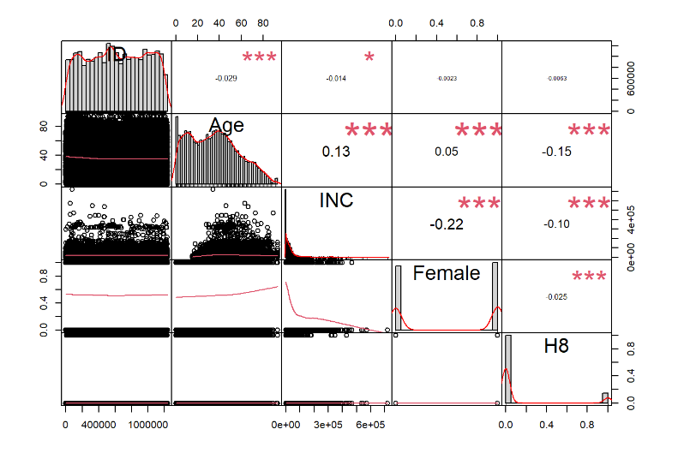
Finding Correlation in Data
The Continuous variables of Data is initially fed into a Correlation Matrix to find how they interplay with each other.
This Matrix helped in realising that “H8” Variable is just “1” for a minority of the datapoints provided.
It also indicates that there is some correlation between this variable and income variable.
This means that change in one of these affects the other one in some manner.

Slide 4
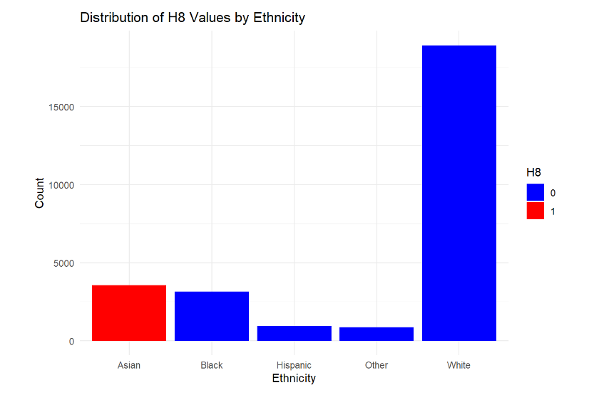
Focusing on a Single Variable
To further analyse the finding from last slide, the “H8” variable is selected for a deeper analysis.
After a few experimentation, something interesting was found between “H8” and “Eth” variables.
The figure on the side clearly depicts that “H8” is “1” only for Asian Ethnicity.
This means that the Asian community tends to live in houses with shared spaces, but is that a preference or an obligation?

Slide 5
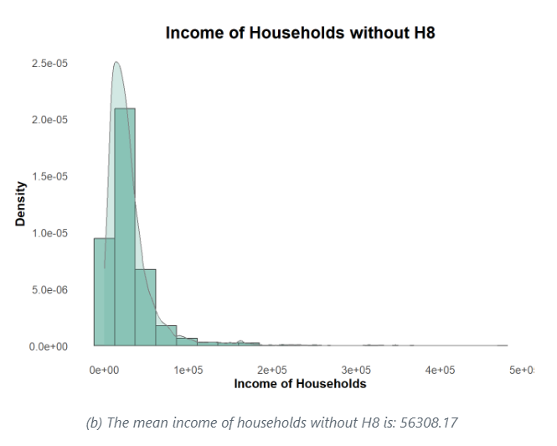
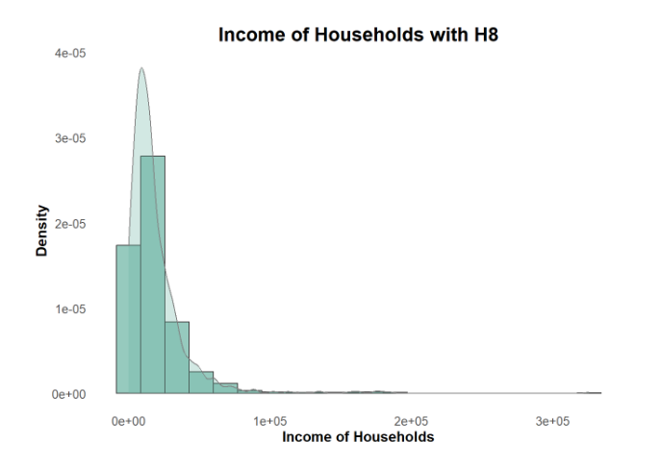
Hypothesis and its verification.
Upon comparing the average incomes of people living with “H8” turns out to be way lower than the ones living without it.
This means that households with lower average income tend to sacrifice some privacy to save money on rent.

Slide 6

Conclusion
The analysis of census data reveals a strong connection between household privacy and the financial hurdles, especially in the Asian Community.
This conclusion was drawn on basis of core Data Science principles such as Correlation in variables, Subsetting Data and further Exploratory Data Analysis.
This report can help us unravel the financial disparities and their consequences that lead to a socioeconomic disturbance.

Slide 7
References
**Wilke, C. O. (2022). ggridges: Ridgeline Plots in 'ggplot2'.** [Online] Available at: https://CRAN.R-project.org/package=ggridges
**Wickham, H. (2016). ggplot2: Elegant Graphics for Data Analysis.** [Online] Available at: https://ggplot2.tidyverse.org
**Peterson, B. G., & Carl, P. (2020). PerformanceAnalytics: Econometric Tools for Performance and Risk Analysis.** [Online] Available at: https://CRAN.R-project.org/package=PerformanceAnalytics
**Peng, J., Wu, W., Lockhart, B., Bian, S., Yan, J. N., Xu, L., ... & Wang, J. (2021). DataPrep.EDA: Task-Centric Exploratory Data Analysis for Statistical Modeling in Python.** Proceedings of the 2021 International Conference on Management of Data. doi: [10.1145/3448016.3457330](http://dx.doi.org/10.1145/3448016.3457330)
**Kartik, D., Nayyar, A., & Mitra, U. (2018). Sequential Experiment Design for Hypothesis Verification.** doi: [10.48550/ARXIV.1812.01137](https://arxiv.org/abs/1812.01137)

